Slide 1
Data engineering with Azure Databricks
Notes:
Before delivering this presentation, review the associated modules on Microsoft Learn (https://aka.ms/mslearn-azure-databricks) and complete the exercises.
Before starting your delivery, prepare a lab environment for the first demonstration by running the setup script.

Slide 2

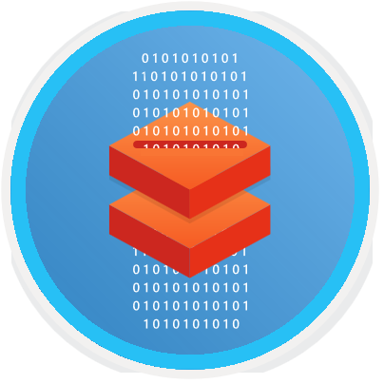
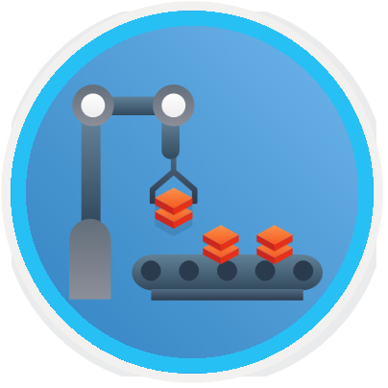
Agenda
Explore Azure Databricks
Use Apache Spark in Azure Databricks
Run Azure Databricks notebooks in Azure Data Factory

Slide 3
Explore Azure Databricks

Slide 4
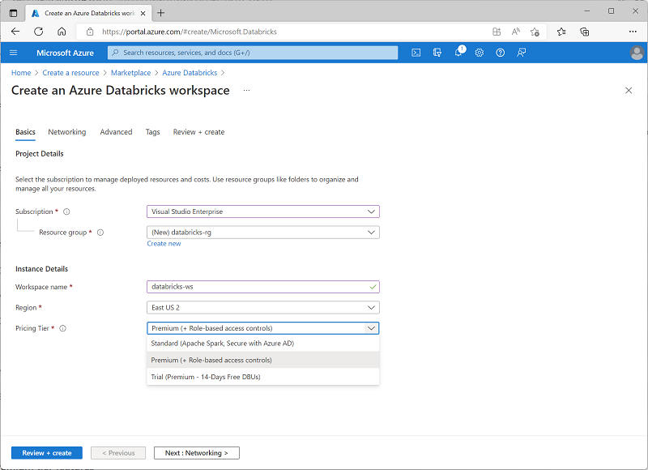
What is Azure Databricks?
Fully managed, cloud-based data analytics platform
Built on Apache Spark
Web-based portal
Provisioned as an Azure resource
Standard tier
Premium tier
Trial
Notes:
Azure Databricks is a version of the popular Databricks platform hosted on Azure. It was created in partnership between Microsoft and Databricks.
Although the focus of this course has been on performing data engineering with Azure Synapse Analytics, many organizations want to use Databricks for some of the same tasks for multi-cloud compatibility or cloud portability reasons, or because they have existing data solutions based on Databricks.

Slide 5
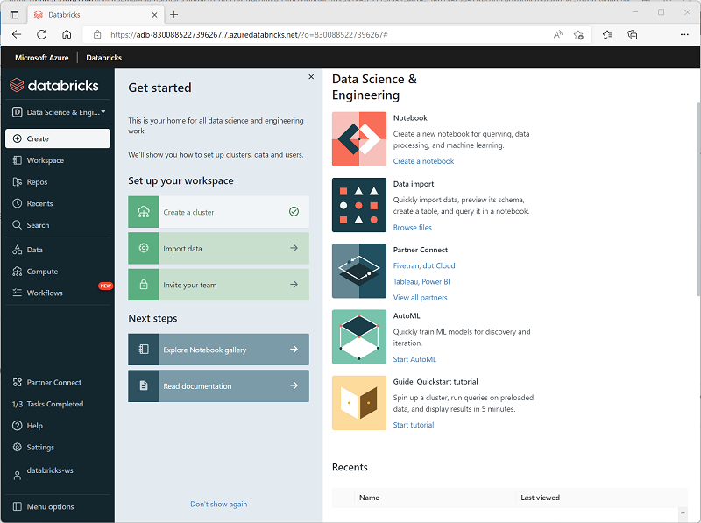
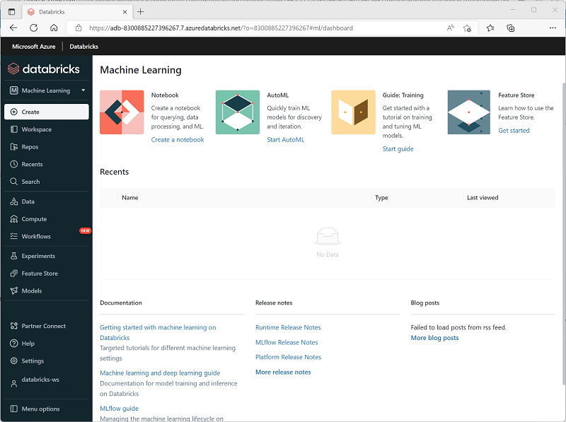
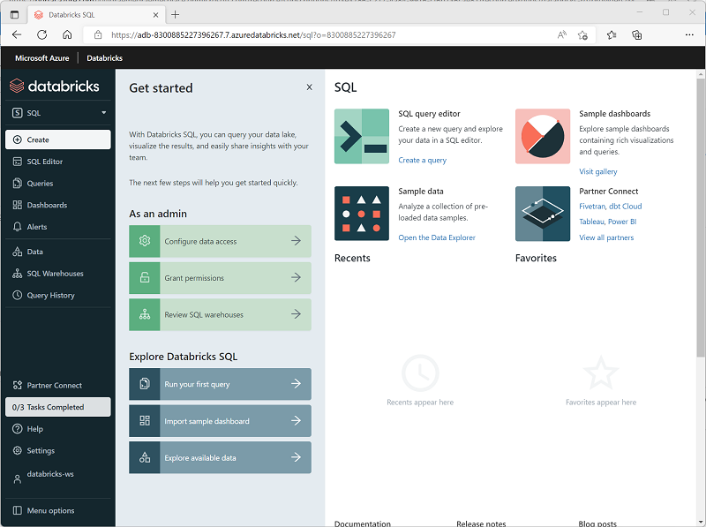
Azure Databricks workloads
Data Science and Engineering | Machine Learning | SQL
Use notebooks to run Apache Spark code to manipulate and explore data | Train predictive models using SparkML and other machine learning frameworks | Store and query data in relational tables using SQL Only available in Premium tier workspaces
Notes:
The three workloads supported in Azure Databricks are reflected in the three role-specific views in the Azure Databricks portal. In this course, we’ll focus on the Data Science and Engineering workload, which is primarily used to analyze and process data using Apache Spark.

Slide 6












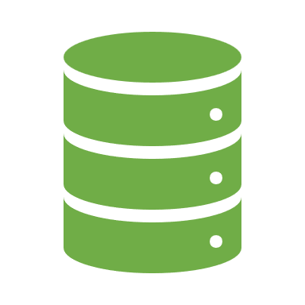



Key concepts
Δ
Apache Spark clusters provide highly scalable parallel compute for distributed data processing
Databricks File System (DBFS) provides distributed shared storage for data lakes
Notebooks provide an interactive environment for combining code, notes, and images
Metastore provides a relational abstraction layer, enabling you to define tables based on data in files
Delta Lake builds on the metastore to enable common relational database capabilities
SQL Warehouses provide relational compute endpoints for querying data in tables
Notes:
Many of the same concepts are relevant in Azure Synapse Analytics – particularly when applying Spark workloads. Clusters in Azure Databricks are the equivalent of Spark pools in Azure Synapse Analytics. The DBFS file system in Azure Databricks performs the same distributed data storage role as data lake storage linked services in Azure Synapse Analytics. Notebooks in Azure Databricks share many similarities with notebooks in Azure Synapse Analytics. The metastore is a standard Spark construct in both Azure Databricks and Azure Synapse Analytics, and enables Spark SQL to overlay relational table schema onto data in files and to support Delta Lake tables. One significant difference between Azure Databricks and Azure Synapse Analytics is the implementation of SQL Warehouses; in Azure Databricks these are more similar to Lake Databases in a serverless SQL pool than a data warehouse in a dedicated pool in that the data is not stored in relational storage, but rather as files in the DBFS file system. SQL Warehouses offer a SQL-optimized compute engine with support for standard SQL processing semantics; but maintains a separation between query processing and data storage.

Slide 7

Demo: Explore Azure Databricks
You can try this for yourself later by following the instructions at the link below:
https://aka.ms/mslearn-adb
Notes:
The demonstration will take around 30 minutes.
Tell students that they can try the steps for themselves after class, though they may need to use their own Azure subscription if a hosted environment is not provided.

Slide 8

Knowledge check
You plan to create an Azure Databricks workspace and use the SQL persona view in the Azure Databricks portal. Which of the following pricing tiers can you select?
Enterprise
Standard
Premium
You need to use Spark to process data in files, preparing it for analysis. Which persona view should you use in the Azure Databricks portal?
Data Science and Engineering
Machine Learning
SQL
You've created an Azure Databricks workspace in which you plan to use code in notebooks to process data. What must you create in the workspace?
A SQL Warehouse
A Spark cluster
A Windows Server virtual machine
Notes:
Allow students a few minutes to think about the questions, and then use the animated slide to reveal the correct answers.

Slide 9
Use Apache Spark in Azure Databricks

Slide 10
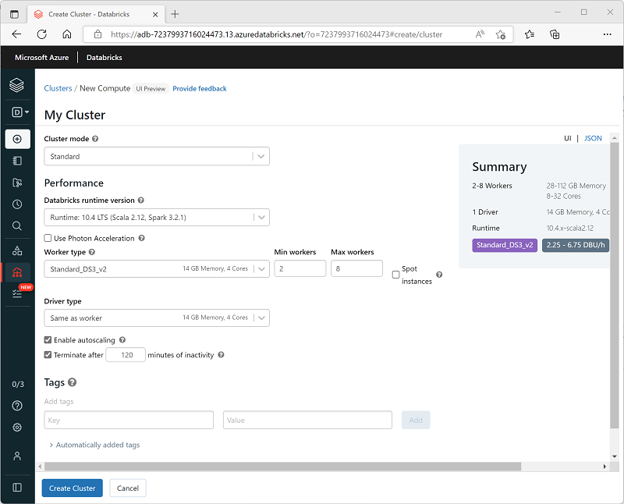
Create a Spark cluster
Create a cluster in the Azure Databricks portal, specifying:
Cluster name
Cluster mode (standard, high-concurrency, or single-node)
Databricks Runtime version
Worker and driver node VM configuration
Autoscaling and automatic shutdown
Notes:
The first step in using Spark in Azure Databricks is to create a Spark cluster, similarly to creating a Spark pool in Azure Synapse Analytics.

Slide 11
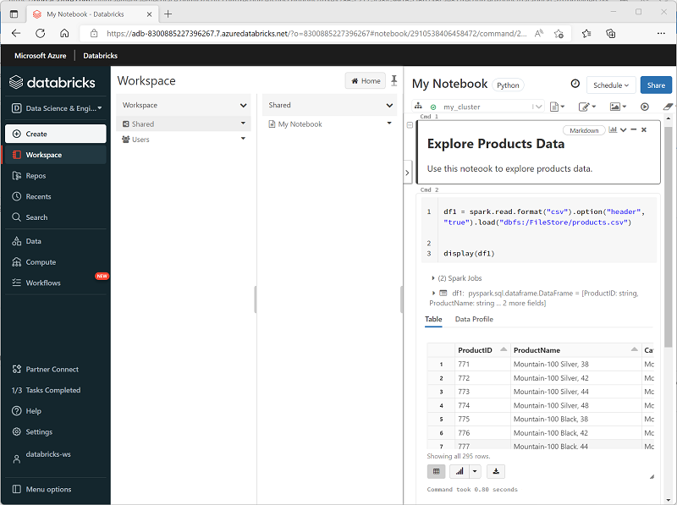
Use Spark in notebooks
Interactive notebooks
Syntax highlighting and error support
Code auto-completion​
Interactive data visualizations
The ability to export results
Notes:
Notebooks in Azure Databricks are similar to notebooks in Azure Synapse Analytics (and other common notebook standards, like Jupyter notebooks). There are some user interface differences, but the basic structure of markdown and code cells is the same.

Slide 12
Use Spark to work with data files
Dataframe API
%pyspark
df=spark.read.load('/data/products.csv',
format='csv',
header=True
)
display(df.limit(10))
Spark SQL API
%pyspark
df.createOrReplaceTempView("products")
%sql
SELECT Category, COUNT(ProductID) AS ProductCount
FROM products
GROUP BY Category
ORDER BY Category
Notes:
Using Spark in Azure Databricks is essentially the same as using Spark in Azure Synapse analytics (or any Apache Spark implementation)

Slide 13
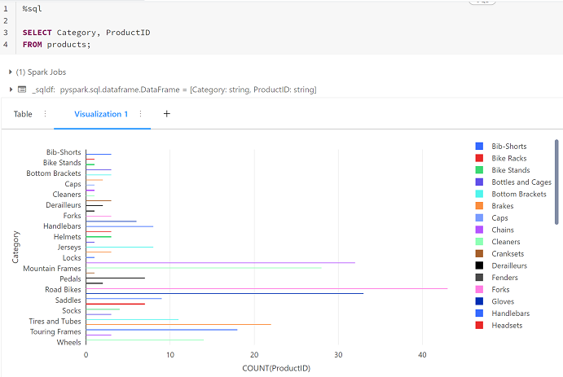
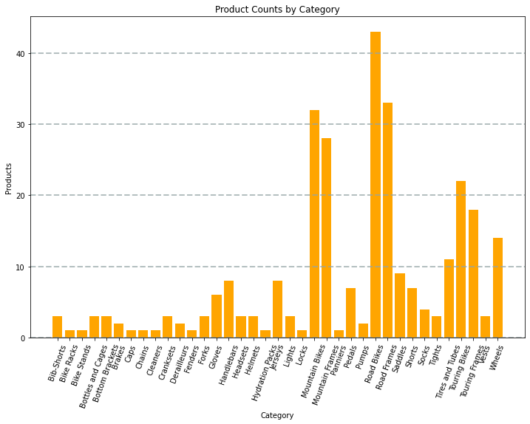
Visualize data
Built-in charts
Graphics packages
from matplotlib import pyplot as plt
fig = plt.figure(figsize=(12,8))
plt.bar(x=data['Category'],
height=data['ProductCount'],
color='orange’)
plt.show()
Notes:
Built-in data visualizations in Spark notebooks can be quite sophisticated and interactive. Additionally, when using an Azure Databricks SQL Warehouse, you can create dashboards of data visualizations for business users to consume. Many professional data analysts and data scientists however prefer to use standard graphics libraries like Matplotlib and Seaborn to create custom visualizations in Spark code.

Slide 14

Exercise: Use Spark in Azure Databricks
Use the hosted lab environment provided, or view the lab instructions at the link below:
https://aka.ms/mslearn-databricks-spark
Notes:
The exercise will take a minimum of 45 minutes to complete, including 5-10 minutes at the start to set up the environment.
Not all students work at the same pace, so you should allow an hour or more as necessary for your class.
While students are completing the exercise, you can prepare for the next demonstration by running the setup script for that exercise.

Slide 15
Knowledge check
Which definition best describes Apache Spark?
A highly scalable relational database management system
A virtual server with a Python runtime
A distributed platform for parallel data processing using multiple languages
You need to use Spark to analyze data in a parquet file. What should you do?
Load the parquet file into a dataframe
Import the data into a table in a serverless SQL pool
Convert the data to CSV format
You want to write code in a notebook cell that uses a SQL query to retrieve data from a view in the Spark catalog. Which magic should you use?
%spark
%pyspark
%sql
Notes:
Allow students a few minutes to think about the questions, and then use the animated slide to reveal the correct answers.

Slide 16
Run Azure Databricks notebooks in Azure Data Factory

Slide 17




Azure Databricks notebooks and pipelines
Use notebooks to develop and test data transformation code
Incorporate notebooks into data ingestion and transformation pipelines using Azure Data Factory or Azure Synapse Analytics
Run pipelines on-demand, at scheduled times, or in response to events
%pyspark
[#code]
Notes:
Notebooks often encapsulate data transformations or analytical operations that you want to automate as a repeatable process. To accomplish this, you can include Azure Databricks notebooks in an Azure Data Factory (or Azure Synapse Analytics) pipeline.

Slide 18
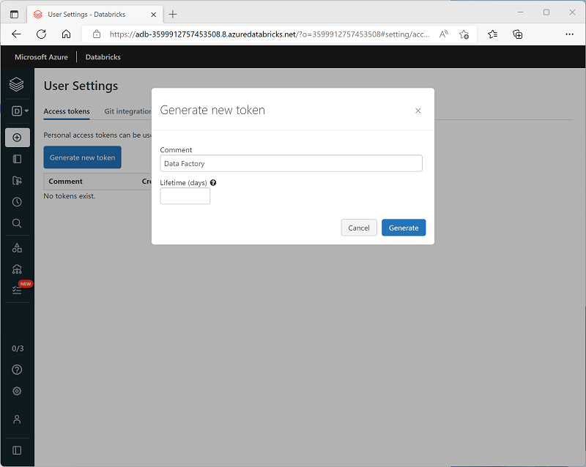
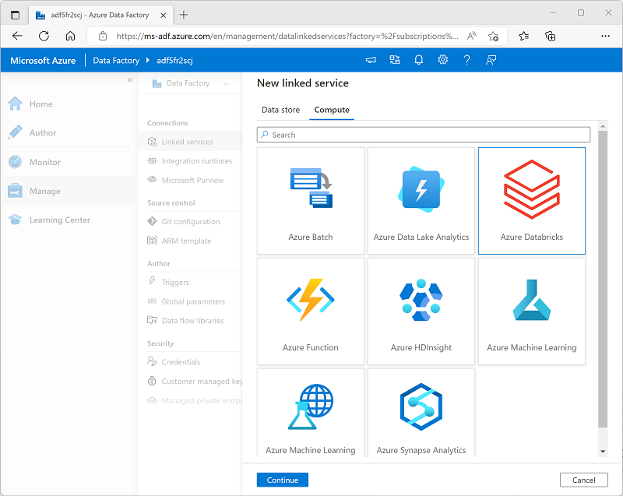
Create a linked service for Azure Databricks
1. Generate an access token for your workspace
2. Create a linked service in Azure Data Factory
Notes:
In order to run notebooks in Azure Databricks, your pipeline runtime needs to be able to access the Azure Databricks workspace securely. To accomplish this, you can generate an access token in Azure Databricks and use it to define a linked service in Azure Data Factory (or Azure Synapse Analytics).

Slide 19
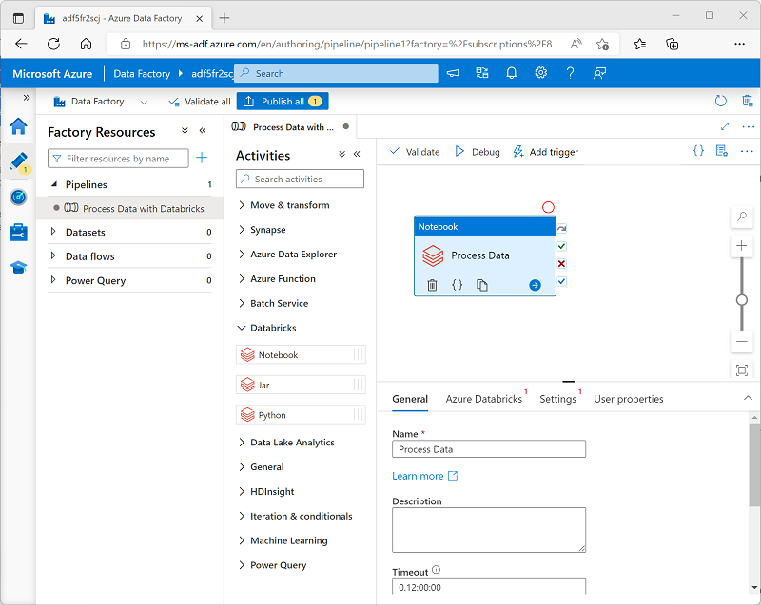
Use a Notebook activity in a pipeline
Add a Notebook activity to a pipeline, specifying:
General properties such as name, timeout, and number of retries
Azure Databricks properties - the linked service for your workspace
Settings, such as the notebook path and parameter details
User properties to define custom configuration values
Notes:
There are multiple Databricks activities – including compiled Java executables (JARs) and Python scripts. To run a notebook, you must use the Notebook activity.
(Note that the Databricks activities are similar to the Synapse activities – be sure to use the right ones!)

Slide 20
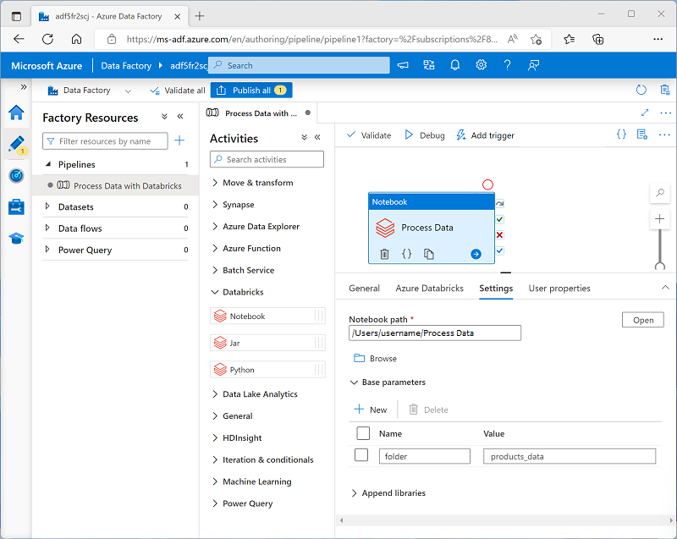
Use parameters in a notebook
Use the dbutils library to work with parameters
# define parameter with default value
dbutils.widgets.text("folder", "data")
# Get input parameter value if passed
folder = dbutils.widgets.get("folder")
...
# Return output parameter
path = "dbfs:/{0}/products.csv".format(folder)
dbutils.notebook.exit(path)
Set parameter values in notebook activity settings
Notes:
To use parameters in an Azure Databricks notebook, you need to define the parameters in the notebook code by using the dbutils library. This is different from defining parameters in a Synapse Analytics notebook (in which you can toggle the Parameter setting for a code cell to use standard variable declarations as parameters). The basic approach is the same though, with the assigned value for the parameter being used as a default value when no parameter is passed.

Slide 21
Demo: Run an Azure Databricks Notebook with Azure Data Factory
You can try this for yourself later by following the instructions at the link below:
https://aka.ms/mslearn-databricks-factory
Notes:
The demonstration will take around 40 minutes.
Tell students that they can try the steps for themselves after class, though they may need to use their own Azure subscription if a hosted environment is not provided.

Slide 22
Knowledge check
You want to connect to an Azure Databricks workspace from Azure Data Factory. What must you define in Azure Data Factory?
A global parameter
A linked service
A customer managed key
You need to run a notebook in the Azure Databricks workspace referenced by a linked service. What type of activity should you add to a pipeline?
Notebook
Python
Jar
You need to use a parameter in a notebook. Which library should you use to define parameters with default values and get parameter values that are passed to the notebook?
notebook
argparse
dbutils.widget
Notes:
Allow students a few minutes to think about the questions, and then use the animated slide to reveal the correct answers.

Slide 23
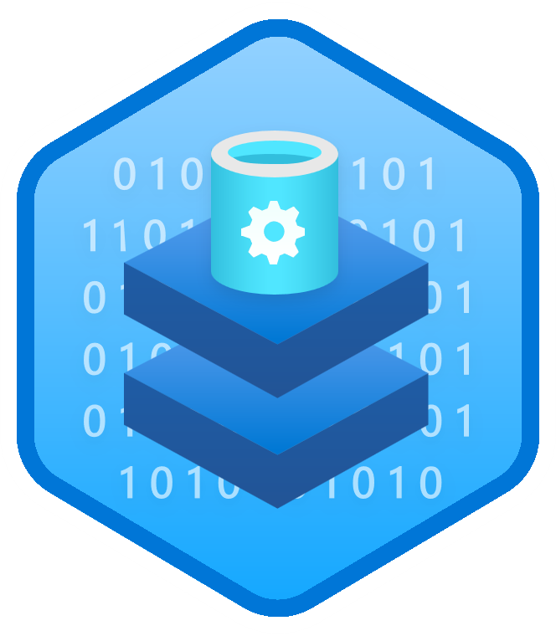
Further reading
Data engineering with Azure Databricks
https://aka.ms/mslearn-azure-databricks
Notes:
Encourage students to review the online material on Microsoft Learn on which this presentation is based.

